Slide 1
Writing winning Graduate Fellowship and Graduate Research Applications
Mary Anne Walker
Spring 2017

Slide 2
Identify Funding Sources
Research funding opportunities and consider less competitive sources of funding Apply to several different sources:
– National Science Foundation Graduate Research Fellowship
Program (GRFP)
– NASA Harriett G. Jenkins Predoctoral Fellowship Program
– Environmental Protection Agency's Science to Achieve Results
– the U.S. Education Department's Jacob K. Javits Fellowships
Program
– USAID Donald M. Payne International Development Fellowship
- Fulbright Schuman
Foundations (Beckman, IBM, Rockefeller, Mott, Dow, Hertz, Ford, Carnegie, Kress)
Professional Associations (SSRC Dissertation Proposal Development
Fellowships)
– International Organizations – World Bank, EU

Slide 3
Reading the Instructions
Guidelines and Forms
Note Limitations
Deadlines
Format/specific requirements
Establish a Calendar

Slide 4
Your Ideas
Must be interesting and understandable to a broadly-trained audience
Should be clearly presented - don’t get lost in the details
– Include a summary diagram or model early to highlight the problem and specific aims

Slide 5
Plan Ahead
Start writing
down your
ideas into a draft
Rewriting helps to clarify ideas

Slide 6
Tailor Proposal to Funding Agency
² Outline your proposal according to the criteria for which points are awarded
² Read other successful proposals
² Research what others have done in your area of interest and focus on a specific idea in your writing
² Include citations in your proposal, you will be rated on this
² Fill an existing gap in research
² Use course work to design your research ideas
² Write clearly, avoid jargon
² Format, use bullets and SPELL CHECK
² Utilize an external reader unfamiliar with your science
² Use statistics and graphics to display multiple pieces of information

Slide 7
It’s All About You~
Demonstrate that you can conceptualize a research path
Your entire application counts, not just the research plan

Slide 8
Applications of Your Research
How will your project
further social goals?
Does your research have policy implications?

Slide 9
Investigate
How is your project unique?
Who is doing similar work?
Use statistics to show where there’s a gap in scientific knowledge that you aim to
fill

Slide 10
Recommendation Letters
• Choose a champion, not a big name scientist who may not be invested in you and share your proposal
• Have them attest to your finest academic qualities
• Discuss evidence that your work is supported by the department
include: - use of technology
- quantitative skills
- creativity, critical thinking
- language skills

Slide 11
Budgeting for Research Programs
What is a direct cost?
Costs allowed to be charged directly to the grant:
Salaries are wages (vacations, holidays, sick leave, of employees working on objectives of a grant or contract – i.e. direct labor costs).
Other employee fringe benefits allocable on direct labor employees.
Consultant services contracted to accomplish specific
grant/contract objectives.
Travel of (direct labor) employees.
Materials, supplies and equipment purchased directly for use on a specific grant or contract.
Communication costs such as long distance telephone calls
identifiable with a specific activity

Slide 12
What are indirect costs (IDC)?
Expenses of doing business that are necessary for the operation of the organization or program and activities it performs.
Costs such as heat, light, trash and snow removal, accounting –
IDC rates are used to distribute these costs
IDC are real expenses that afford the
grantor access to your services

Slide 13
Research Programs: Budgeting and Accounting
Be realistic in terms of costs:
• Travel
– Visas, Passport Photos, Inoculations, Medicine
– Accommodations
– Per diem
– Local Transportation
• Supplies
• Communications
• Equipment (computers, software, lab materials)
• Publications
• Conferences/Dissemination Networks
• Monitoring and Evaluation Assessment

Slide 14
Budgeting Goals
Accurately estimate needs for funding
If required, properly estimate cost-sharing to meet
Use format required by the funding agent

Slide 15
The Budget: Line – By - Line
Salaries
Always include as the first line-item
Note % level of effort to complete a task o Amounts paid on a grant for salaries are NOT
supplemental pay
Include inflation factor (4-7%)
Fringe Benefits
Use cost-of-living rate increase for future periods

Slide 16
Common Budget Mistakes
• Include your time as a level of % effort
• Make certain the budget adds up correctly
• Put commas in numbers, easier to read
• Use a column format, numbers align on right
• Label all budget categories, leave nothing blank
• Be realistic about the time you can commit

Slide 17
The Review Process, or Writing Backward for Progress
Identify the reviewer’s criteria
Highlight and define specific elements as priorities when appropriate
Be redundant if the point is essential….
Remember, this is a “sales tool”

Slide 18
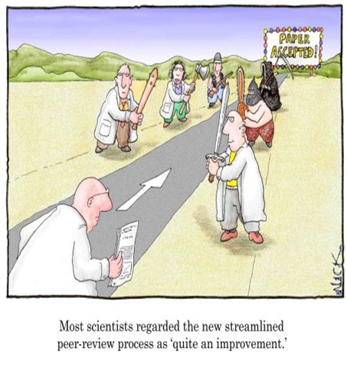
The Review Process
• How does it work?
• Who does the reviews?
• What do you need to do?

Slide 19
How Proposals Are Reviewed
Most federal agencies use the “peer review” process – experts from backgrounds similar to the applicant evaluate proposals based on a set criteria
The sponsor’s own personnel, and judgment may be made based on personal interviews or knowledge of the applicant’s strengths. Certain foundation grants may be reviewed in this manner
At times the review process may not be used at all.
Procurements issued to a specific entity may be used based on prior work done by the applicant or by the need for a quick turn-
around. Usually the sponsor is required to have rationale for their decision to use this type of “sole source” awarding.

Slide 20
General Comments
You are writing for the reviewers
Page limits and deadlines are established
Follow the guidelines
Get to know the program officer
Try to obtain the criteria guidelines reviewers
will be using

Slide 21
The Goal is in Sight
Write with a positive attitude
Have specific aims and objectives
Leadership + the Plan = $
investment

Slide 22
$$ Reward
Apply to multiple funding sources
Seek reviewer’s comments to help you with other submissions

Slide 23
Be Persistent!
No one is 100% successful
Request a debriefing with the funder to find out how you can improve chances for next time
Revise and resubmit proposal

Slide 24
Thank you.
Mary Anne Walker mawalker@msu.edu

