Slide 1
The Grants Process:
An Introduction to Proposal
Development
Mary Anne Walker
Fall 2017

Slide 2
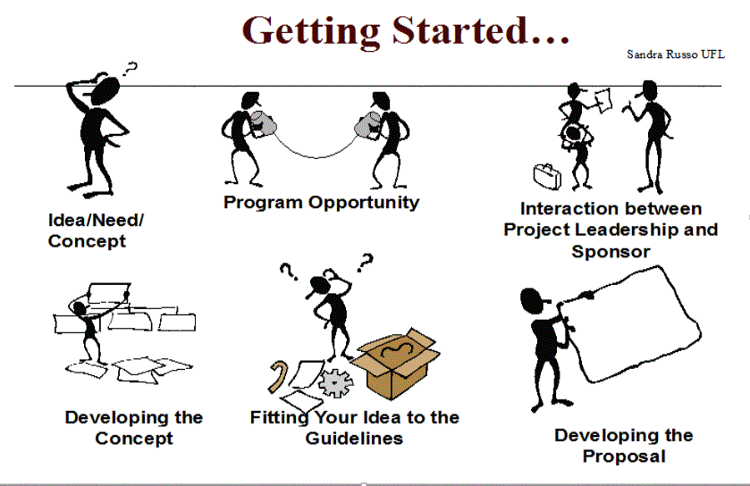

Slide 3
Resources
Grant: Resources to support your project idea
Cooperative Agreement: Grant with substantial involvement from the funder
Contract : Terms and conditions established for goods and services to be delivered on a schedule

Slide 4
Project Resources
Work with funding agency on defining priorities
Maintain a dialogue with program officers

Slide 5
Industry/Corporate Support
New market interests
Link to applied R&D interests

Slide 6
Locating Funding for Projects
Sci Val
USG
The Foundation Center
The Grantsmanship Center
The Gates Foundation
OIE
MSU Libraries

Slide 7
Foundations
Review trends in resource allocation, past grantees
Align yourselves with those institutions that have a common goal match to your signature programs
Research web pages for updated information

Slide 8
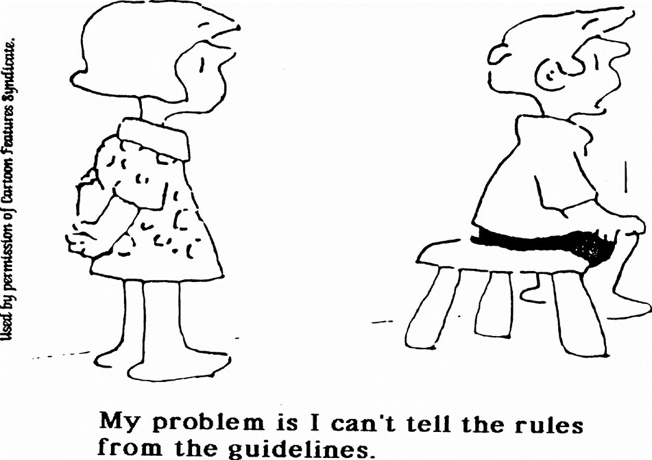
The best way to determine if the program fits your needs is to read the program description and the guidelines
Contact the Program Officer, create a dialogue

Slide 9
Reading the Instructions
Model Guidelines
Forms
Signatures
Deadlines
Format
Specific requirements
Establish a Calendar

Slide 10
Getting Started:
Read and understand the guidelines
Review past awardees
Develop a plan
Identify supporting data needed and key graphic representations
Establish a timeline for completion of the proposal
Identify the primary writer and the role of the other collaborators
Contact the granting agency for information

Slide 11
The 90% Rule of Grant writing
Understanding the guidelines/requirements
Developing a sound
project concept, including data
Identifying and correcting the gaps in required information
Expanding the concept to match the guidelines
Identifying costs
______________________________________________________
Writing/Submitting the proposal
90%
10%

Slide 12
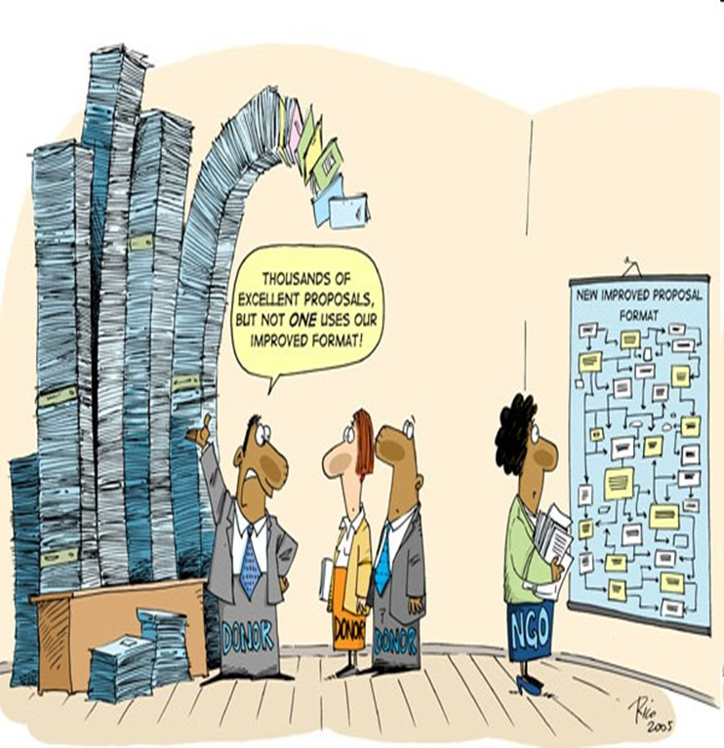
A pre-proposal by any other name…
Concept Paper
Letter of Interest/ Inquiry
White Paper
Preliminary Proposal

Slide 13
Starting with a Basic Concept Note
Brainstorm to develop a framework for the final proposal
Answer questions relating to the project, can you articulate the plan start to finish?
Identify who will develop each section, what other information is needed, are partners required to fill in the gaps?

Slide 14
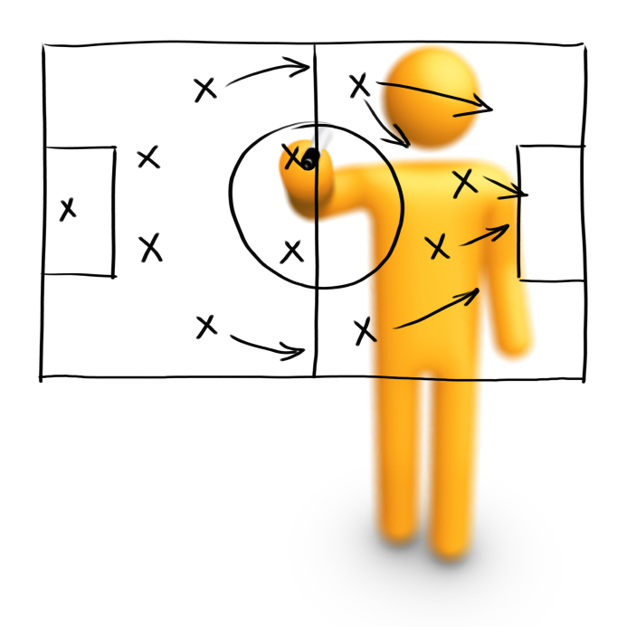
Developing a Project Proposal
Strategic Visioning
Outline Project Description
Who?
What?
Where?
How Long?
Why?

Slide 15
The Function of a Proposal
The Function of a Proposal
Presents a compelling argument for funding
Represents the organization’s credibility and capacity
Describes the project in persuasive terms
Provides mechanism for evaluation
Tests the ability of the individual to articulate/ conceptualize: If you can state it well, you probably can deliver the project

Slide 16
The Essential Components of a Proposal
Introduction
Statement of Need/Rationale
Goals/Objectives
Organizational Support
Personnel
Expected Outcomes
Evaluation
Budget and Budget Narrative

Slide 17
Description of the Approach to Solve the Problem
Identifies then modifies, improves, expands, previous efforts; may suggest a new approach
Discusses specific actions and implementation
Justifies these in terms of the outcomes to be achieved
Provides information as to how the process and outcome will be measured

Slide 18
Links Between Actions to be Taken and Statement of Problem
The problem you are addressing is always the essential element
Each action should link the proposed solution to the problem
Whenever possible, each action should also tie directly to how you will measure your success (Note: sometimes identifying the completion date of an activity can be evidence of success)
Budgets evolve from the actions required

Slide 19
Are others doing similar work? How is your project unique?

Slide 20
Who Will Perform the Work?
Identify the persons/organization who will perform the proposed work
Identify collaborators
State their expertise, roles on the project, and capacity to do the work
Network early with potential collaborators; you may need documentation from them that they agree to help in the project’s activities
Develop capability/qualification statements

Slide 21
When to Partner
When the sponsor requires collaboration
When elements of the work are being done in separate locations
When facilities or expertise are not adequate to do all the work
When an external evaluation component is needed
When specific expertise is needed
When the project design mandates comparisons
When costs could be leveraged by having organizations with common goals working together

Slide 22
Partnering Pitfalls
Be clear about
whom is responsible for what and how resources are to be allocated
Timeliness
Deliverables
Indirect Cost Return

Slide 23
Summary Implementation Plan
Develop outline in accordance with a timeline
Achieve what results by when?
Use charts to relate multiple pieces of information

Slide 24
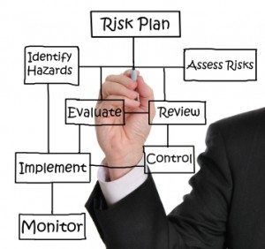
Proposed Management Plan
Establish a management structure for the project
Create a management entity comprised of those with a vested interest in the outcome of the project: Board of Advisors

Slide 25
Make It Easy for a Funding Agency to Choose You
Keep it simple
Plain language, fine to use technical context but no jargon
Less is more
Know what others are doing so you can initiate or
complement a program
Transparency in budgeting
Engage an external reviewer who is unfamiliar with the
subject matte

Slide 26
Establishing Contact with the Funding Agent
It promotes your institution
It tests the possible compatibility between the potential funder and your institution
It permits you to gather additional information about the funder and possible reaction to your proposal before you submit

Slide 27
Bringing the Elements Together: How to Demonstrate Success
State the anticipated solution and how you will know when it is achieved
Solution
Identify methods to solve the problem in terms of previous approaches and how this model is appropriate
Proposed Approach
Use data, figures, substantiated documentation to further clarify the specific problem
Specific Problem
Use data, figures, substantiated documentation to state the need
Need
Notes:
150
153
Body of Knowledge Cross References: I.B.; I.B.2; I.B.3; I.B.4
Curriculum Reference: 1.IV.B.2
Goal: This module will describe the basic elements of a good proposal, and will focus on the ways that these elements must come together to form a quality, cohesive application.
Part of Stand-Alone module; refer to the Building Blocks for full detail. This specific concept is included in the excerpt from The Grant Advisor, found in the Building Blocks.

Slide 28
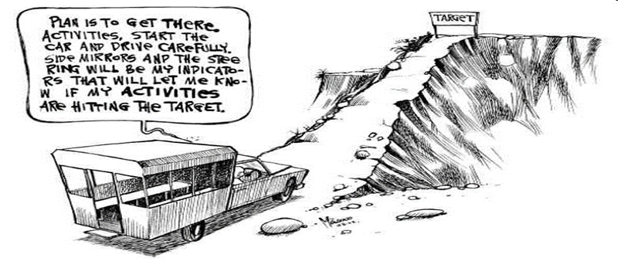
Monitoring and Evaluation: Demonstrates impact and measures progress
Are you meeting targets?
Who, How and When?
Two types
Fiscal
Programmatic
Accountability
External Evaluation
Self-Correction
Opportunity

Slide 29
Impact and Outcome
Provides the sponsor with evidence that the project was completed
Provides documentation of impact
Identifies areas for future improvement
Identifies “dead ends” – can be helpful in identifying what doesn’t work
Describes how the outcome and useful information can be shared with others
NOTE: Sponsors are accountable for the investment of their funds; a well-defined evaluation or measurement of outcome is important

Slide 30
Steps to Sustainability
Seek additional funding
Integrate training on partnership activities to build capacity
Ensure community involvement
Train those invested in project to continue efforts once the project partners have fulfilled commitments

Slide 31
Budgeting and Accounting
Be realistic in terms of cost:
Travel
Accommodations
Local Transportation
Supplies
Communications
Equipment (materials, etc.)
Publications
Evaluation Services
Miscellaneous

Slide 32
Budgeting Goals
Accurately Estimate Needs for Funding
Project
Properly Estimate Cost-Sharing to Meet the
Requirements
Use format required by the funding agent

Slide 33
The Budget Line – By-Line
Salaries
Always include as the first line-item
Note % of effort to complete a task
Amounts paid on a grant for salaries are NOT supplemental pay
Include inflation factor (4-7%)
Fringe Benefits
Use rate increase for future periods

Slide 34
The Budget Line – By - Line
All Other Direct Costs
Subcontracts for collaborative projects
with other partners
Indirect Costs

Slide 35
Common Budget Mistakes
Include your time as a level of % effort
Make certain the budget adds up correctly
Put commas in numbers, easier to read
Use a column format, numbers align on right
Label all budget categories, leave nothing blank
Be realistic about the time you can commit, if you have 3 projects at 50% time and they are all funded, you’re in trouble!

Slide 36
Packaging the Proposal
Spell check content before giving to an external reviewer for comment
Cover letter
Review your checklist

Slide 37
The Review Process, or Writing Backward for Progress
Identify the reviewer’s criteria
Highlight and define specific elements as priorities when appropriate
Be redundant if the point is essential….
Remember, this is a
“sales tool”

Slide 38
How are Proposals Reviewed
Proposals are reviewed in a variety of different ways: most federal agencies use the “peer review” process – experts from backgrounds similar to the applicants evaluate proposals based on a set criteria
Proposals may also be reviewed by the sponsor’s own personnel, and judgment may be made based on personal interviews or knowledge of the applicant’s strengths. Certain foundation and corporate grants may be reviewed in this manner
At times the review process may not be used at all. Procurements issued to a specific entity may be used based on prior work done by the applicant or by the need for a quick turn-around. Usually the sponsor is required to have back-up for their decision to use this type of “sole source” awarding. Some sponsors issue a cooperative agreement to create a long-term relationship with an organization to facilitate procurement for specific tasks

Slide 39
General Comments
You are writing for the reviewers
Page limits and deadlines are established
Follow the guidelines even if they don’t
“flow” as you would like
Get to know the program officer
Try to obtain the criteria guidelines reviewers will be using

Slide 40
Your Ideas
Must be interesting and understandable to a broadly-trained audience
Clear communication - don’t get lost in the details
Include one summary diagram or model early to highlight the problem and specific aims

Slide 41
The Goal is in Sight
Write with a positive attitude
Have specific aims and objectives
Leadership + the Plan = $ investment

Slide 42
The Review
Clear communication
Concisely worded
Easy and interesting to read
Communicate the importance of your work to the community

Slide 43
Final Guidance
Always have an external reader that doesn’t know about your project to give you honest feedback
It often takes a TEAM
Seek advice from colleagues, mentors
Allow enough time for final review

Slide 44
When Failure is Not Failure…
Sometimes sponsors want to get to know you…your initial proposal may be a “gate opener” for discussion
Some sponsors have a formal structure for resubmission; they expect it
Peer Review and Commentary is a significant tool for eventual funding

Slide 45
Be Persistent!
No person or organization is funded every time they submit
Request a debriefing with the funder to find out how you can improve chances for next time
Revise and resubmit proposal

Slide 46
Thank you.
Mary Anne Walker
Director of International Programs in Engineering
mawalker@msu.edu
(517)432-3536

